Slide 1
SIM GAME
Minh Nguyen, hau ha

Slide 2
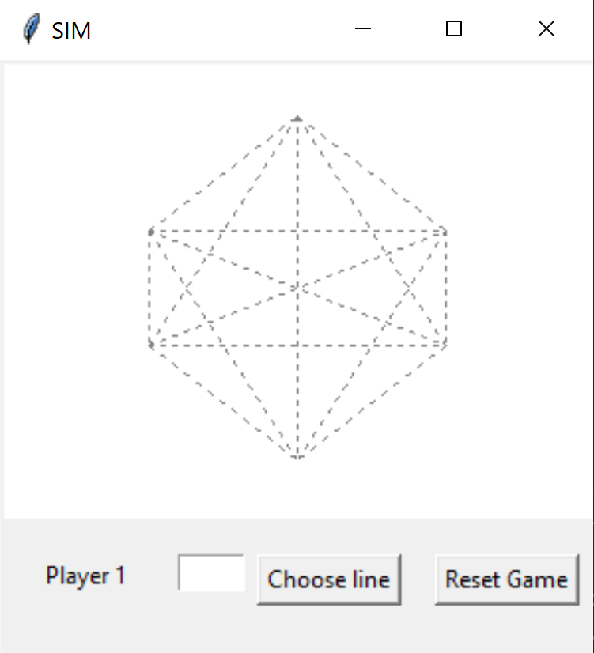
OVERVIEW
Zero Sum game
Two players take turn take turns coloring any uncolored lines (15 possible lines)
One player colors in one color, and the other colors in another color
The goal is to avoid drawing a triangle
Only triangles with the dots as corners count, intersections of lines are not relevant
Player who completes a triangle of the same color loses immediately
Each line is labeled with a letter from ‘a’ to ‘o’

Slide 3
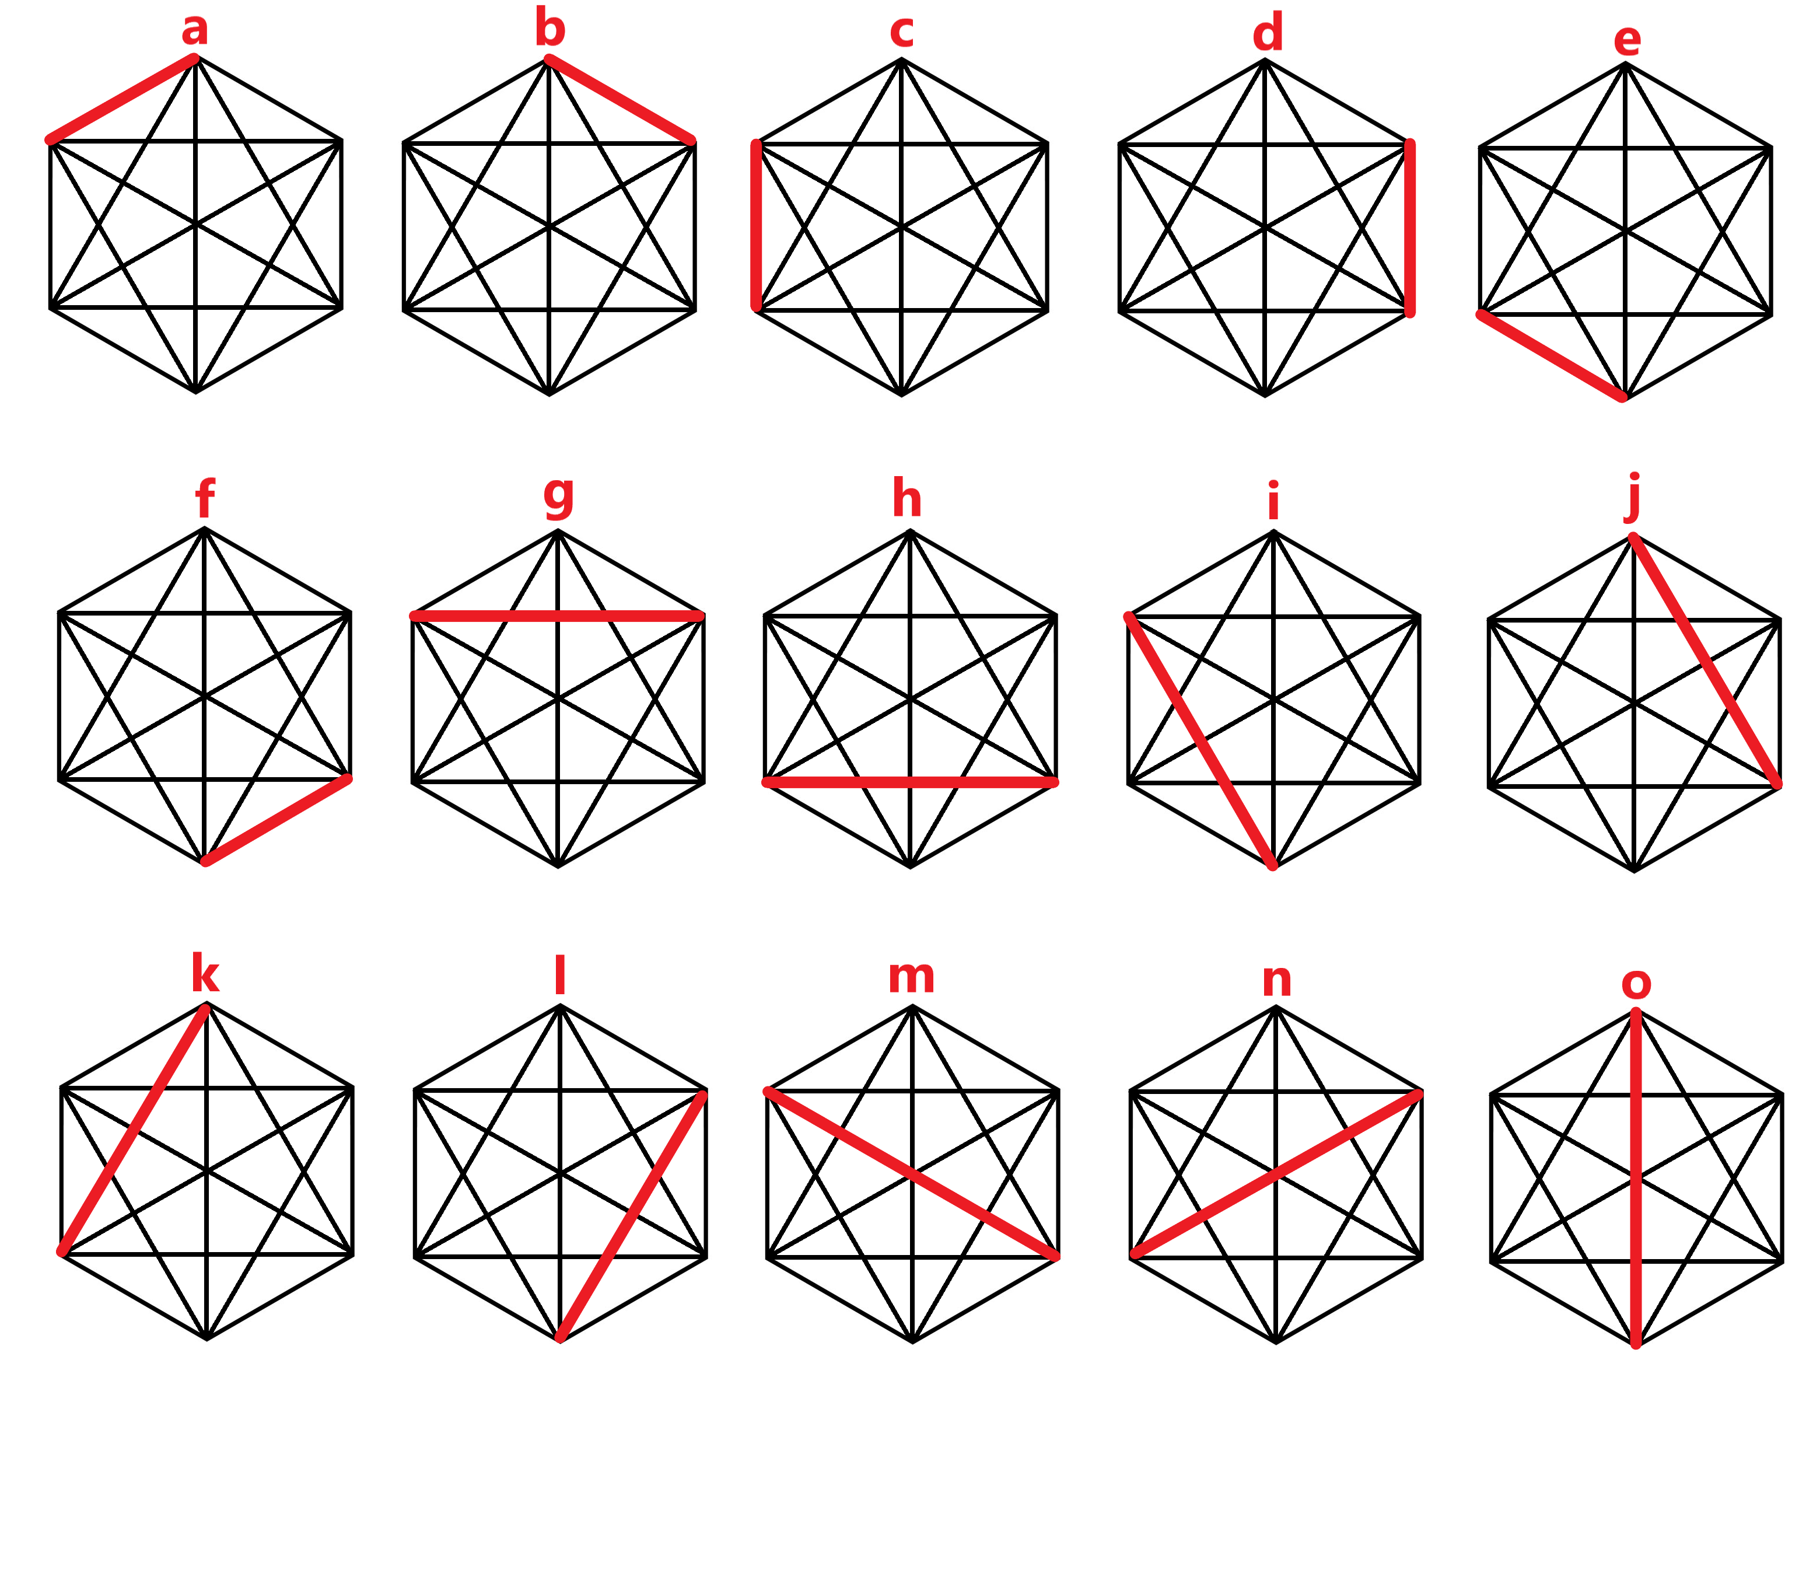

Slide 4
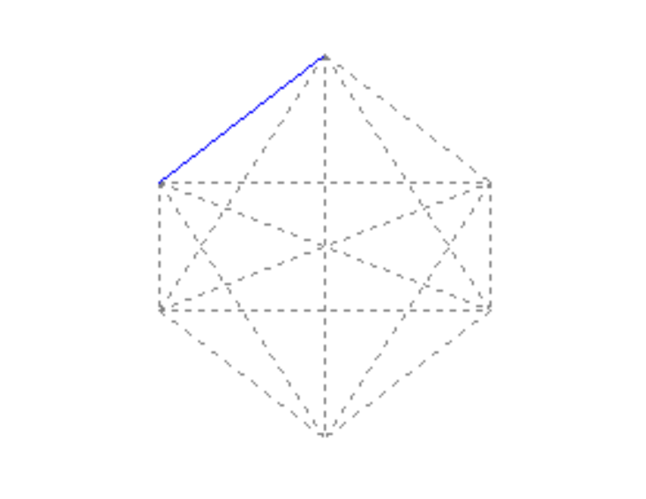
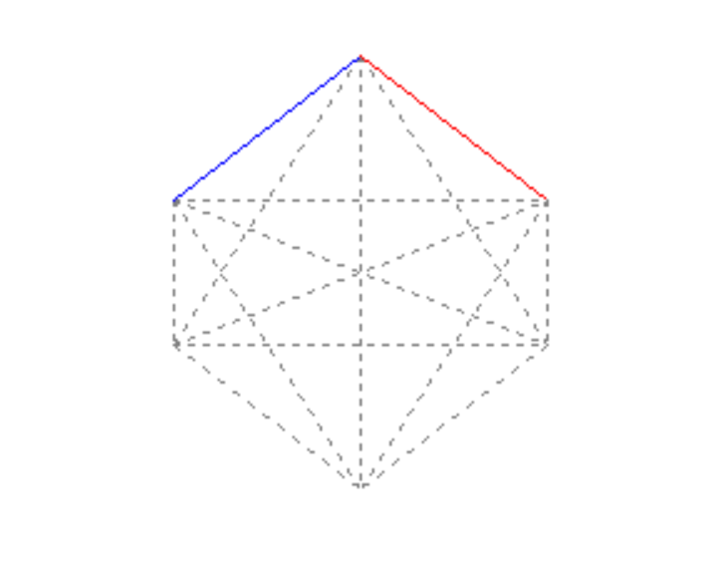
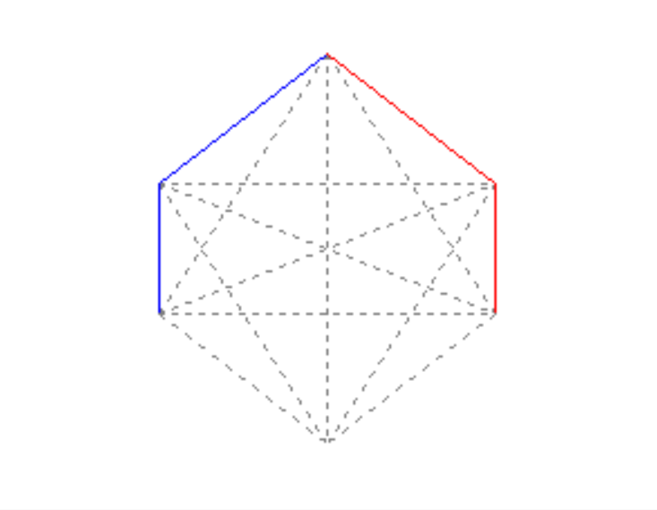

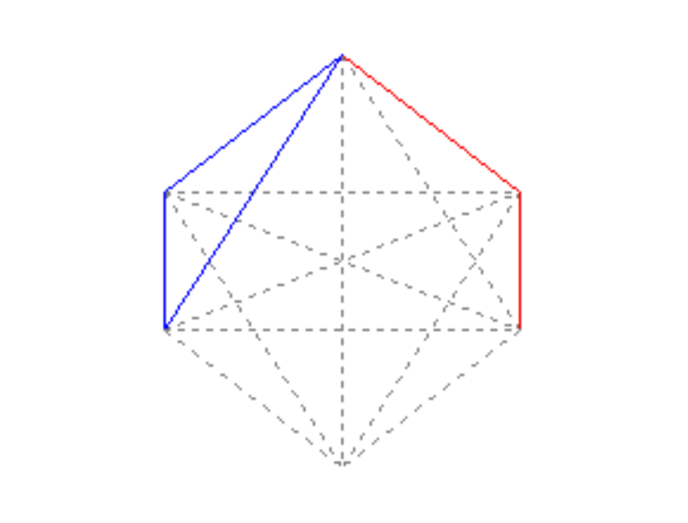
GAMEPLAY EXAMPLE
a
b
c
d
b
YOU LOST!
k

Slide 5
GENETICS ALGORITHM (GA)
GA is an innovative approach composed of many biological imitations, such as the chromosome representation, genetic operators, population selection, and fitness functions
GA represents a practical and no sweat approach to finding a solution by letting the machine try different solutions in time until we get a good approximation to the best solution.

Slide 6
INPUTS
Function F = a – b*depth
Range: 69 < a < 151, 0 < b < 4
Population: 10 chromosomes
Mutation probability = 0.01
With each chromosome, we will test the function with 5 games
Always select top 4 chromosomes
Combining crossover and mutation to create 6 offspring
→ New population

Slide 7
INITIAL POPULATIONS
chromosome C = [134, 3] : 1/5 games win
chromosome C = [97, 3] : 3/5 games win
chromosome C = [72, 2] : 5/5 games win
chromosome C = [104, 3] : 2/5 games win
chromosome C = [100, 2] : 2/5 games win
chromosome C = [95, 1] : 3/5 games win
chromosome C = [110, 1] : 1/5 games win
chromosome C = [91, 2] : 4/5 games win
chromosome C = [102, 3] : 2/5 games win
chromosome C = [143, 3] : 1/5 games win
F(1) = 3+5+4+3 = 15/20 games win
Chromosome yields:
C2 = 20%
C3 = 33.3%
C6 = 20%
C8 = 26.6%
Total games win: 24/50 games

Slide 8
NEXT GENERATION (2nd)
chromosome C = [91, 2] : 4/5 games win
chromosome C = [97, 3] : 3/5 games win
chromosome C = [72, 2] : 5/5 games win
chromosome C = [97, 3] : 3/5 games win
chromosome C = [91, 2] : 4/5 games win
chromosome C = [95, 1] : 3/5 games win
chromosome C = [72, 2] : 5/5 games win
chromosome C = [91, 2] : 4/5 games win
chromosome C = [97, 3] : 3/5 games win
chromosome C = [72, 2] : 5/5 games win
F(2) = 5+5+4+5 = 19/20 games win
Chromosome yields:
C1 = 21%
C3 = 26.3%
C7 = 26.3%
C10 = 26.3%
Total games win: 39/50 games

Slide 9
NEXT GENERATION (3rd)
chromosome C = [72, 2] : 5/5 games win
chromosome C = [91, 2] : 4/5 games win
chromosome C = [72, 2] : 5/5 games win
chromosome C = [91, 2] : 4/5 games win
chromosome C = [72, 2] : 5/5 games win
chromosome C = [72, 2] : 5/5 games win
chromosome C = [72, 2] : 5/5 games win
chromosome C = [91, 2] : 4/5 games win
chromosome C = [91, 2] : 4/5 games win
chromosome C = [72, 2] : 5/5 games win
F(3) = 5+5+5+5 = 20/20 games win
Chromosome yields:
C1 = 25%
C3 = 25%
C5 = 25%
C6 = 25%
Total games win: 46/50 games

Slide 10
RESULTS
For generation 3rd :
Best chromosome [72, 2] with 5/5 games win
Best performance F = 20 games win
Average performance F = (15+19+20)/3 = 18 games win
No mutation was found due to the mutation probability

Slide 11
Thank you for listening!

